Slide 1
COS 212 Data Compression: Basics & Huffman Coding

Slide 2
Computational Complexity
Computational Complexity
Time Complexity
How quickly does it execute?
Space Complexity
How much memory does it require?
Time complexity reduction
Through algorithm design and algorithm optimisation
Space complexity reduction
Through data structure design and data compression

Slide 3
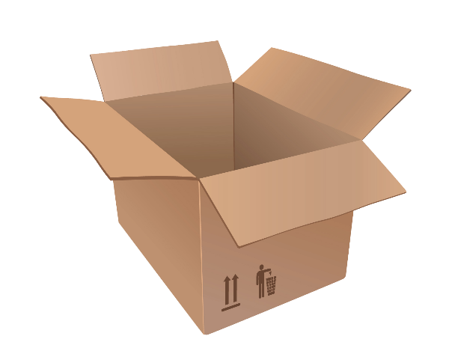
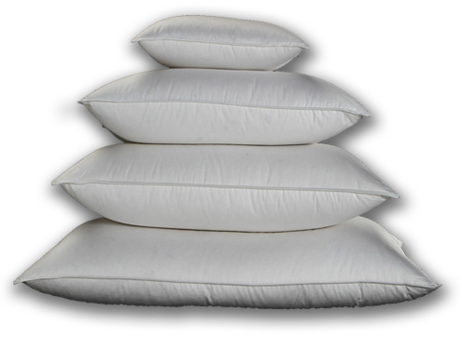
Data Compression
Suppose you want to ship pillows, and have to pay per box
The more pillows you stuff into a single box, the better
If you squeeze all the air out, more pillows will fit into a box
Once out of the box, the pillows can be fluffed up again
Data compression
“Squeezes the air out of pillows”
Getting rid of irrelevant parts of data that can be restored easily

Slide 4
Information
What is information?
The meaning associated with data
Yes, No, Yes, No, No, Yes
1 0 1 0 0 1
Both sequences contain the same amount of information
Compression maximises the amount of information per bit
How many bits do we need to store information?
Use as few as possible!
For {Yes, No}, use 1 bit, that can be either 1 (Yes) or 0 (No)
What if we had four symbols in a set?
{sunny, rainy, cloudy, foggy} = {0, 1, 2, 3}
If we use binary to represent N = 4, we can use lg N = 2 bits instead
What if we want to encode all 26 letters in the alphabet?
How many bits must be reserved per character?
If we use binary to represent N = 26, we can use lg N = 4.7 = 5 bits
But can we do better?

Slide 5
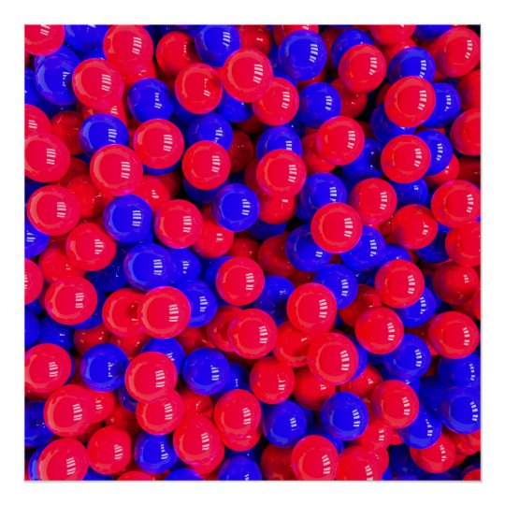
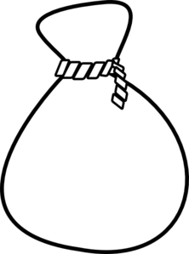
Entropy
Entropy is a measure
Higher entropy denotes more unpredictability, surprise, or chaos
Also considered to be a measure of information
Suppose you have a bag of red and blue marbles
You take a random marble out of the bag
If the bag holds an equal number of red and blue marbles
How surprised would you be by its colour?
In other words, can you predict what colour it will be?
If the bag holds only blue marbles?
If the bag holds mostly red marbles, with 1 or 2 blue ones?

Slide 6
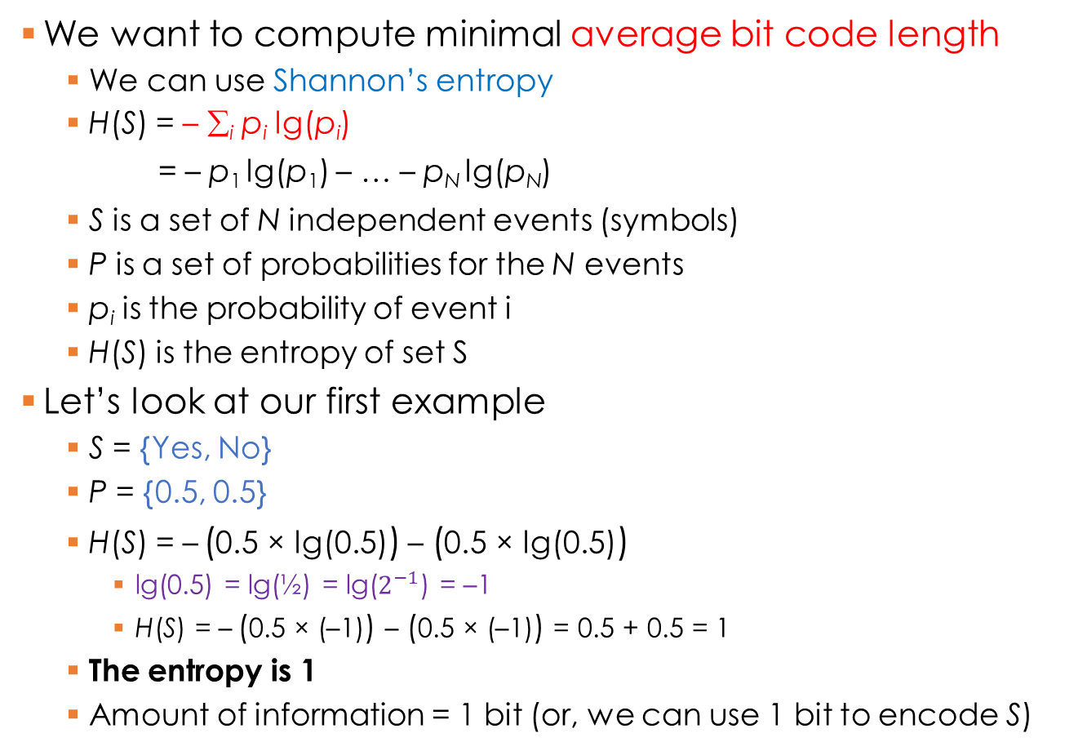
Entropy: Minimal Code Length
We want to compute minimal average bit code length
We can use Shannon’s entropy
H(S) = – ∑_{i} p_{i} lg(p_{i}) = – p₁ lg(p₁) – … – p_{N} lg(p_{N})
S is a set of N independent events (symbols)
P is a set of probabilities for the N events
p_{i} is the probability of event i
H(S) is the entropy of set S
Let’s look at our first example
S = {Yes, No}
P = {0.5, 0.5}
H(S) = – (0.5 × lg(0.5)) – (0.5 × lg(0.5))
lg(0.5) = lg(½) = lg($2^{−1}$) = –1
H(S) = – (0.5 × (–1)) – (0.5 × (–1)) = 0.5 + 0.5 = 1
The entropy is 1
Amount of information = 1 bit (or, we can use 1 bit to encode S)
– lg(p_{i}) is the minimum number of bits needed to represent symbol i occurring with a probability of p_{i}
Data | Yes | No
Probability | 0.5 | 0.5
Encoding | 1 | 0

Slide 7
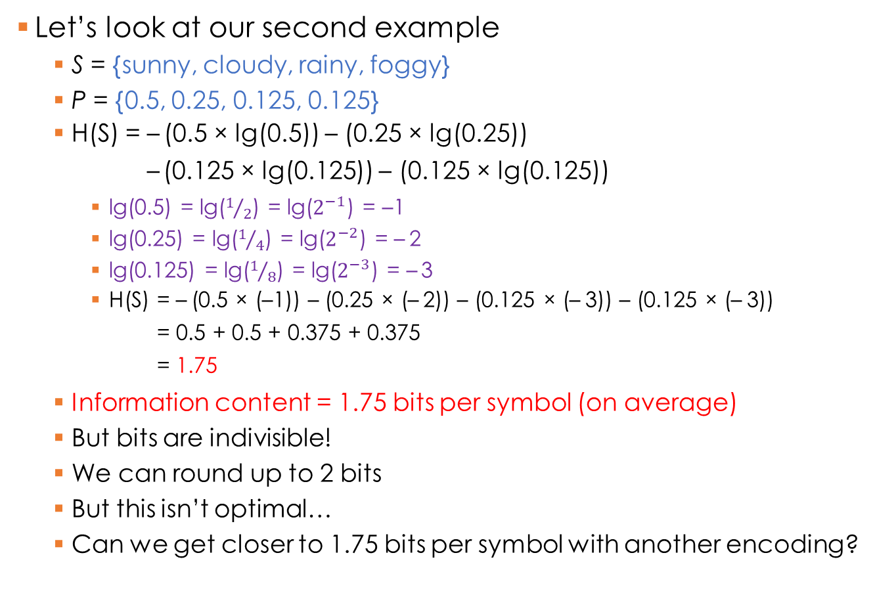
Entropy: Minimal Code Length
Let’s look at our second example
S = {sunny, cloudy, rainy, foggy}
P = {0.5, 0.25, 0.125, 0.125}
H(S) = – (0.5 × lg(0.5)) – (0.25 × lg(0.25)) – (0.125 × lg(0.125)) – (0.125 × lg(0.125))
lg(0.5) = lg($1/2$) = lg($2^{−1}$) = –1
lg(0.25) = lg($1/4$) = lg($2^{−2}$) = – 2
lg(0.125) = lg($1/8$) = lg($2^{−3}$) = – 3
H(S) = – (0.5 × (–1)) – (0.25 × (– 2)) – (0.125 × (– 3)) – (0.125 × (– 3)) = 0.5 + 0.5 + 0.375 + 0.375 = 1.75
Information content = 1.75 bits per symbol (on average)
But bits are indivisible!
We can round up to 2 bits
But this isn’t optimal…
Can we get closer to 1.75 bits per symbol with another encoding?
H(S) = – ∑_{i} p_{i} lg(p_{i}) = – p₁ lg(p₁) – … – p_{N} lg(p_{N})
Data | sunny | cloudy | rainy | foggy
Probability | 0.5 | 0.25 | 0.125 | 0.125
Encoding | 00 | 01 | 10 | 11

Slide 8


Entropy Compression
Calculate the minimum average bit code length
Need an encoding that gets as close to minimum as possible
Not every encoding is good, and some will not even work!
Four properties of an optimal encoding
Each code must represent exactly one symbol
Yes | No
0 | 0
Yes | No
0 | 1

Slide 9
Entropy Compression
Four properties of an optimal encoding
Each code must represent exactly one symbol
Prefix property: No code should be a prefix of another code
Consider the bit sequence 0 1 1 0 0 1 0
We can interpret it as
Or we can interpret it as
Again consider the bit sequence 0 1 1 0 0 1 0
We can only interpret it as
Therefore, the prefix property ensures unambiguous decoding
sunny | cloudy | rainy | foggy
0 | 1 | 01 | 10
The code for sunny is the prefix of the code for rainy The code for cloudy is the prefix of the code for foggy
sunny
, cloudy
, cloudy
, sunny, …
rainy
, rainy, …
, foggy
sunny | cloudy | rainy | foggy
0 | 10 | 110 | 111
No code is the prefix of another code
sunny
, rainy
, sunny
, cloudy

Slide 10
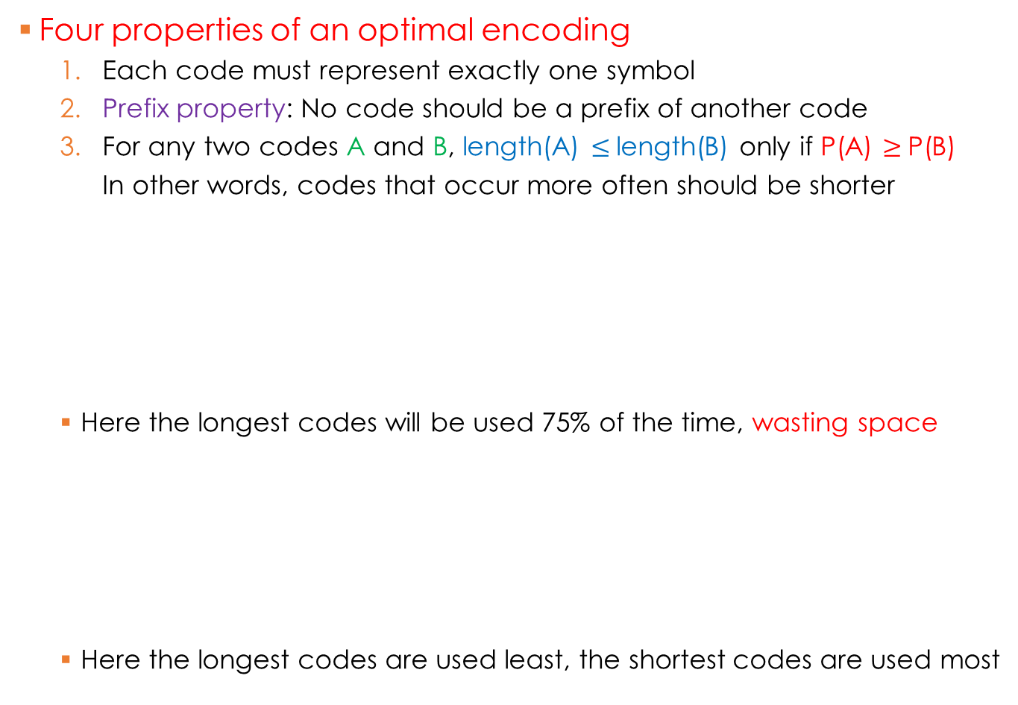
Entropy Compression
Four properties of an optimal encoding
Each code must represent exactly one symbol
Prefix property: No code should be a prefix of another code
For any two codes A and B, length(A) $≤$length(B) only if P(A) $≥$P(B) In other words, codes that occur more often should be shorter
Here the longest codes will be used 75% of the time, wasting space
Here the longest codes are used least, the shortest codes are used most
sunny | cloudy | rainy | foggy
0.5 | 0.25 | 0.125 | 0.125
111 | 110 | 10 | 0
sunny | cloudy | rainy | foggy
0.5 | 0.25 | 0.125 | 0.125
0 | 10 | 110 | 111

Slide 11

Entropy Compression
Four properties of an optimal encoding
Each code must represent exactly one symbol
Prefix property: No code should be a prefix of another code
For any two codes A and B, length(A) $≤$length(B) only if P(A) $≥$P(B)
Every short code must be used as a stand-alone code or a prefix
Short codes (subject to property 2) are 0, 1, 10, 11, 110, 111
Short codes (subject to property 2) are 0, 1, 10, 11
sunny | cloudy | rainy | foggy
0.5 | 0.25 | 0.125 | 0.125
0 | 10 | 1110 | 1111
110 is not used as a stand-alone code or prefix
Unnecessary longer codes have been created
sunny | cloudy | rainy | foggy
0.5 | 0.25 | 0.125 | 0.125
0 | 10 | 110 | 111
All short codes used as a stand-alone code or prefix No unnecessary longer codes have been created

Slide 12
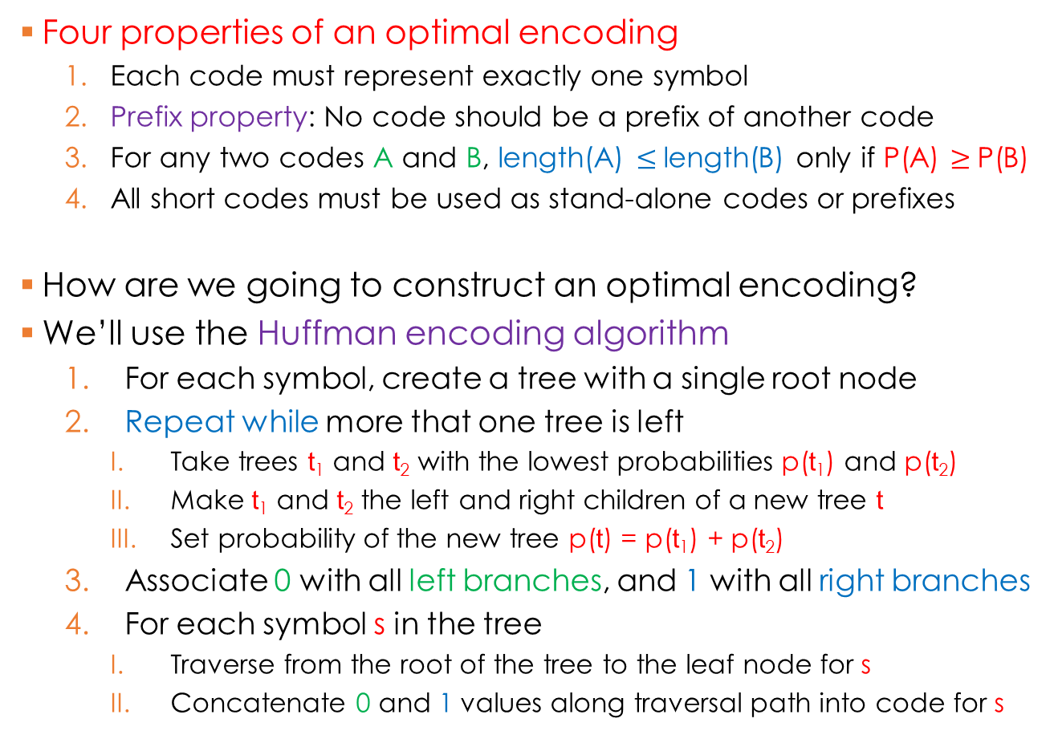
Huffman Coding
Four properties of an optimal encoding
Each code must represent exactly one symbol
Prefix property: No code should be a prefix of another code
For any two codes A and B, length(A) $≤$length(B) only if P(A) $≥$P(B)
All short codes must be used as stand-alone codes or prefixes
How are we going to construct an optimal encoding?
We’ll use the Huffman encoding algorithm
For each symbol, create a tree with a single root node
Repeat while more that one tree is left
Take trees t₁ and t₂ with the lowest probabilities p(t₁) and p(t₂)
Make t₁ and t₂ the left and right children of a new tree t
Set probability of the new tree p(t) = p(t₁) + p(t₂)
Associate 0 with all left branches, and 1 with all right branches
For each symbol s in the tree
Traverse from the root of the tree to the leaf node for s
Concatenate 0 and 1 values along traversal path into code for s

Slide 13
Huffman Coding
Can the while loop be implemented recursively?
For each symbol, create a tree with a single root node
Repeat while more that one tree is left
Take trees t₁ and t₂ with the lowest probabilities p(t₁) and p(t₂)
Make t₁ and t₂ the left and right children of new tree t
Set probability of new tree p(t) = p(t₁) + p(t₂)
Associate 0 with all left branches, and 1 with all right branches
For each symbol s in the tree
Traverse from the root of the tree to the leaf node for s
Concatenate 0 and 1 values along traversal path into code for s
1
1
H_{avg} = (0.5 × 1) + (0.25 × 2) + (0.125 × 3) + (0.125 × 3)
H_{avg} = 0.5 + 0.5 + 0.375 + 0.375
H_{avg} = 1.75 (minimal average bit code length)
0.5
1
0.25
Recall: In each symbol’s multiplication, the left factor is the probability & the right factor is the number of bits in the representation
0
0
0
1
0.5
0.25
0.125
0.125
H_{Huff} = (0.5 × 1) + (0.25 × 2) + (0.125 × 3) + (0.125 × 3)
H_{Huff} = 0.5 + 0.5 + 0.375 + 0.375
H_{Huff} = 1.75 (actual average bit code length)
sunny | cloudy | rainy | foggy
0.5 | 0.25 | 0.125 | 0.125
So, according to entropy, we can’t do better than this encoding!
0
10
110
111

Slide 14
Huffman Coding
Let’s build an encoding for another example
1
1
0.65
0
1
0.34
0.31
0
0
1
0
1
0.35
0.17
0.17
0.16
0.15
A | B | C | D | E
0.35 | 0.17 | 0.17 | 0.16 | 0.15
So, according to entropy, Huffman coding falls short of optimal compression performance
0
100
101
110
111
H_{avg} = –(0.35 × lg(0.35)) – (0.17 × lg(0.17)) – (0.17 × lg(0.17)) – (0.16 × lg(0.16)) – (0.15 × lg(0.15))
H_{avg} = 0.5301 + 0.4346 + 0.4346 + 0.4230 + 0.4105
H_{avg} = 2.2328 (minimal average bit code length)
H_{Huff} = (0.35 × 1) + (0.17 × 3) + (0.17 × 3) + (0.16 × 3) + (0.15 × 3)
H_{Huff} = 0.35 + 0.51 + 0.51 + 0.48 + 0.45
H_{Huff} = 2.3 (actual average bit code length)

Slide 15
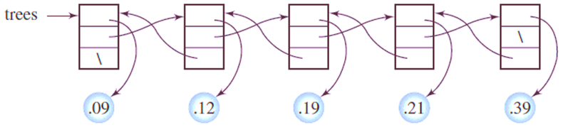
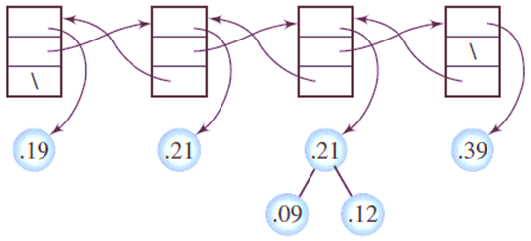
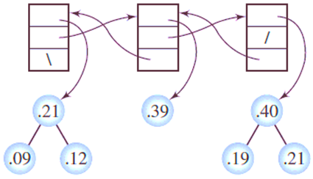
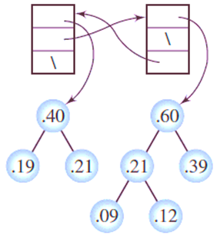
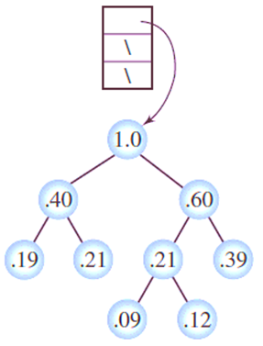
Huffman Coding: Implementation
Use a doubly linked list containing trees, sorted using probabilities
E
D
C
B
A
Each iteration, merge trees in 1st & 2nd nodes, and store in 2nd node Move 2nd node based on merged probability Delete 1st node
C
B
A
A
E
D
E
D
C
B
Implementing list as priority queue is a natural choice
Min-heap also works
Restore heap after removing 1st node
Restore heap after updating 2nd node’s probability
A 11 B 01 C 00 D 101 E 100
C
B
A
E
D
C
B
A
E
D

Slide 16
Huffman Coding: Encoding & Decoding
1
Sender
1
Receiver
1
0.65
0
1
0
1
0.34
0.31
0
0
1
0
1
0
0
1
0
1
0.35
0.17
0.17
0.16
0.15
A | B | C | D | E
0.35 | 0.17 | 0.17 | 0.16 | 0.15
0 | 100 | 101 | 110 | 111
A | B | C | D | E
0
100
101
110
111
BEAD
B
E
A
D
0
1
1
1
0
1
1
0
0
1
Obviously, we must send the compressed data to the receiver
Unfortunately, Huffman trees are not necessarily unique
Different trees are built when there are several valid merge options
Therefore, we must also send the Huffman code tree to the receiver

Slide 17
Huffman Coding: Improving Efficiency
Now let’s create an encoding for pairs of symbols
We need to generate codes for all possible pairs
AA AB AC BA BB BC CA CB CC
Probabilities are computed as the product of the probabilities for both symbols
Encodings are ordered according to entropy
1
0
0
0.51
0
0.23
0.09
0
1
0.05
0
0
1
1
0.3
0.03
0.14
0.28
0
1
1
0
1
1
1
0
1
0
1
1
0.1
0.2
0.7
0.01
0.02
0.02
0.04
0.07
0.07
0.14
0.14
0.49
A | B | C
0.1 | 0.2 | 0.7
AA | AB | BA | BB | AC | CA | BC | CB | CC
0.01 | 0.02 | 0.02 | 0.04 | 0.07 | 0.07 | 0.14 | 0.14 | 0.49
00
01
1
000000
000001
00001
0001
0010
0011
010
011
1
Efficiency of 1st approach = 1.1568 ÷ 1.3 = 88.98 %
Efficiency of 2nd approach = 2.3136 ÷ 2.33 = 99.30 %
H_{avg} = –(0.1 × lg(0.1)) – (0.2 × lg(0.2)) – (0.7 × lg(0.7))
H_{avg} = 0.3322 + 0.4644 + 0.3602
H_{avg} = 1.1568 (minimal average bit code length)
H_{avg} = –(0.01 × lg(0.01)) – 2 × (0.02 × lg(0.02)) – (0.04 × lg(0.04)) – 2 × (0.07 × lg(0.07)) – 2 × (0.14 × lg(0.14)) – (0.49 × lg(0.49))
H_{avg} = 0.0664 + 0.2258 + 0.1858 + 0.5371 + 0.7942 + 0.5043
H_{avg} = 2.3136 (minimal average bit code length)
We’ve improved the efficiency of the compression at the expense of a larger tree
Why would a larger tree present a potential problem in a practical setting?
H_{Huff} = (0.1 × 2) + (0.2 × 2) + (0.7 × 1)
H_{Huff} = 1.3 (actual average bit code length)
H_{Huff} = (0.01 × 6) + (0.02 × 6) + (0.02 × 5) + (0.04 × 4) + 2 × (0.07 × 4) + 2 × (0.14 × 3) + (0.49 × 1)
H_{Huff} = 2.33 (actual average bit code length)

